Slide 1



2021.12.15
BUSINESS PLAN
Joumana | Harrsh | Tianyi | Deepak
ADD Clients Name
ADD Contact Information
SkoolBazar

Slide 2
01
Executive Summary
05
Approach & Methodology
02
Introduction- Plan & Platform
06
Schedule & Benchmarks
CONTENTS
03
Current Analytics & Dashboard (EDA)
07
Cost & Payment Schedule
04
Problem Statement
Legal, Terms & Conditions
08

Slide 3

01
Executive
Summary
SkoolBazar
What are we
SkoolBazar is an E-commerce company that sells original handmade products or digital items through an online portal and mobile application.
The company will cooperate with all levels of education organizations across North America.
Why we are here
Our project is to support those in need by those schools, communities and partners willing to help. The partners & investors are the bridge between the business and our project.

Slide 4
02
Introduction- Quick Overview on Charities
How have schools helped charity ?
99% & 87% of elementary & secondary schools report fund-raising respectively.
Almost 25% of elementary schools raise $20,000 or more.
Various fund-raising activities like pizza lunches, book fairs & holiday gift sales, are held.
The money raised is then used to support charities, fund school trips, purchase new technology, establish student scholarships, etc.
Our project will help low poverty schools and high poverty schools evenly.
Products made by Children
Clothing
Décor
Music
Art/Digital Art
How the fund-raising is done by schools ?
Fund-raising events are held in the school premises targeting the local community.
The money collected is then used for charity.
Notes:
Council of Ministers of Education, Canada (cmec.ca)
Fundraising and fees in Ontario’s schools - People for Education

Slide 5
02
Introduction-Business Plan
Survey done by Skoolbazar
If your able to sell all over Canada using an e-platform, how likely are you to use it ?
Never | Maybe | Certainly
Do you prefer handling the shipping or outsourcing the shipping ?
Handling the shipping | Outsourcing the shipping
Do you prefer handling the packaging or outsourcing the shipping ?
Handling the shipping | Outsourcing the shipping
On a scale of 1 to 5, How beneficial will this e-platform be ?
One – Least beneficial | Five – Most beneficial
Will you recommend this e-platform to others ?
Never | Maybe | Certainly

Slide 6
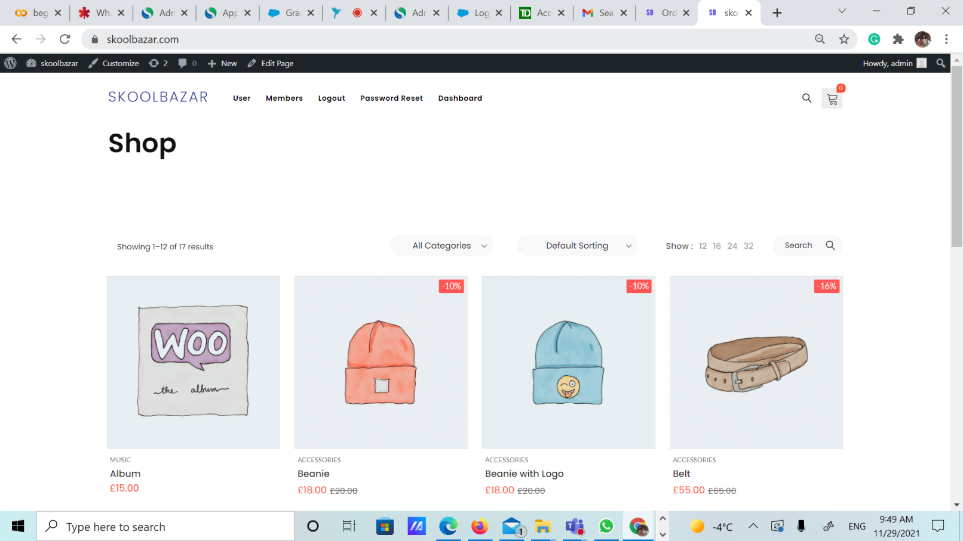
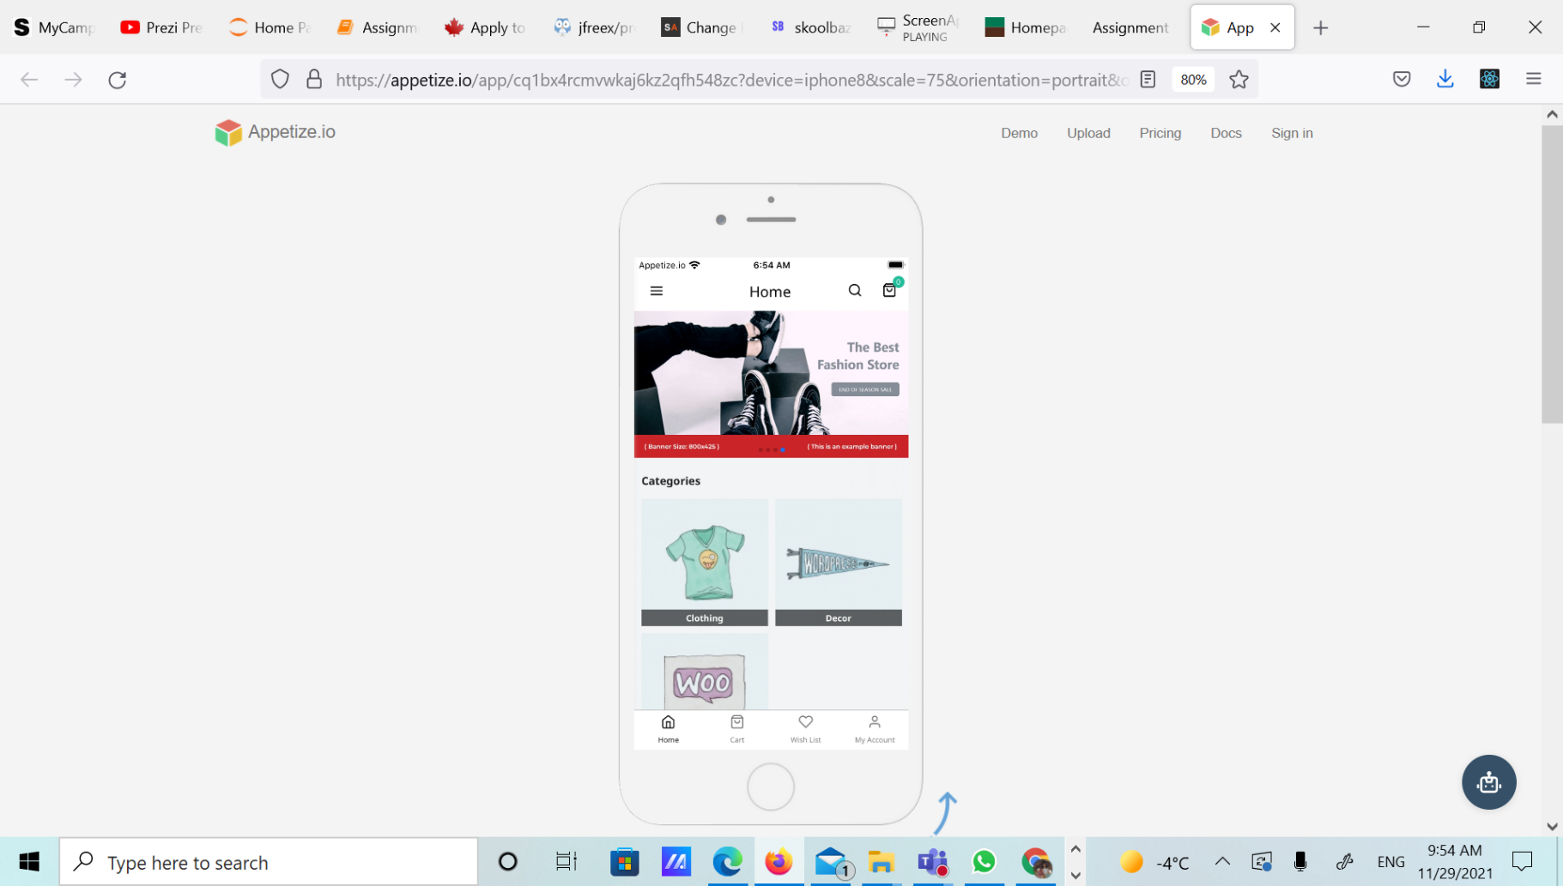
02
Introduction-Our Business Platform
The online application and mobile interface allows schools to create accounts and sell their handmade items, full control of their product catalogue.
Update products and items
Efficient Analytics of their orders and sales
Smooth channel of order process from supplier to consumer
The mobile application will function similarly with constant tracking process, SMS updates and manage changes with orders.
Delivery status and progress
Updates of items on sale or new releases

Slide 7
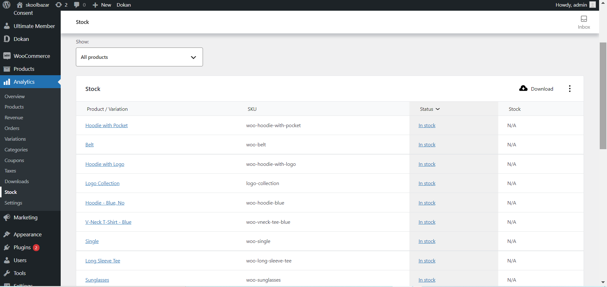
02
Introduction-School Account Example

Slide 8
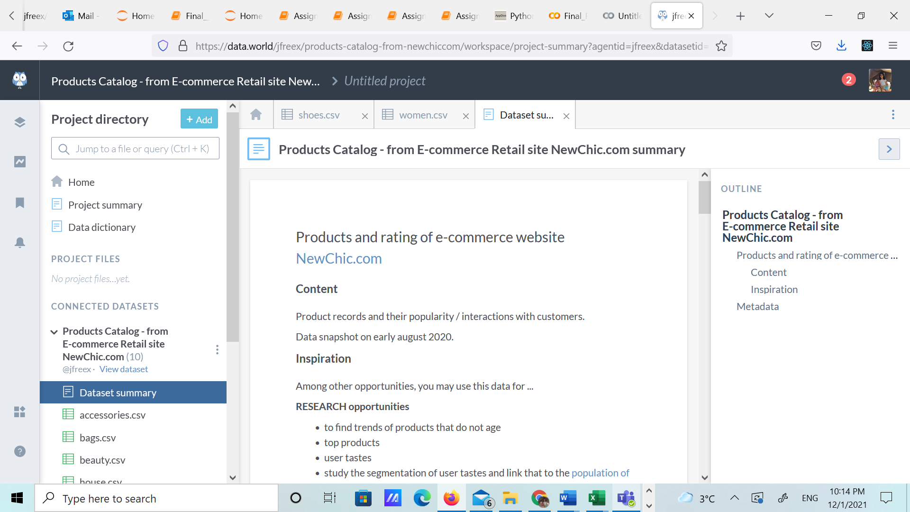
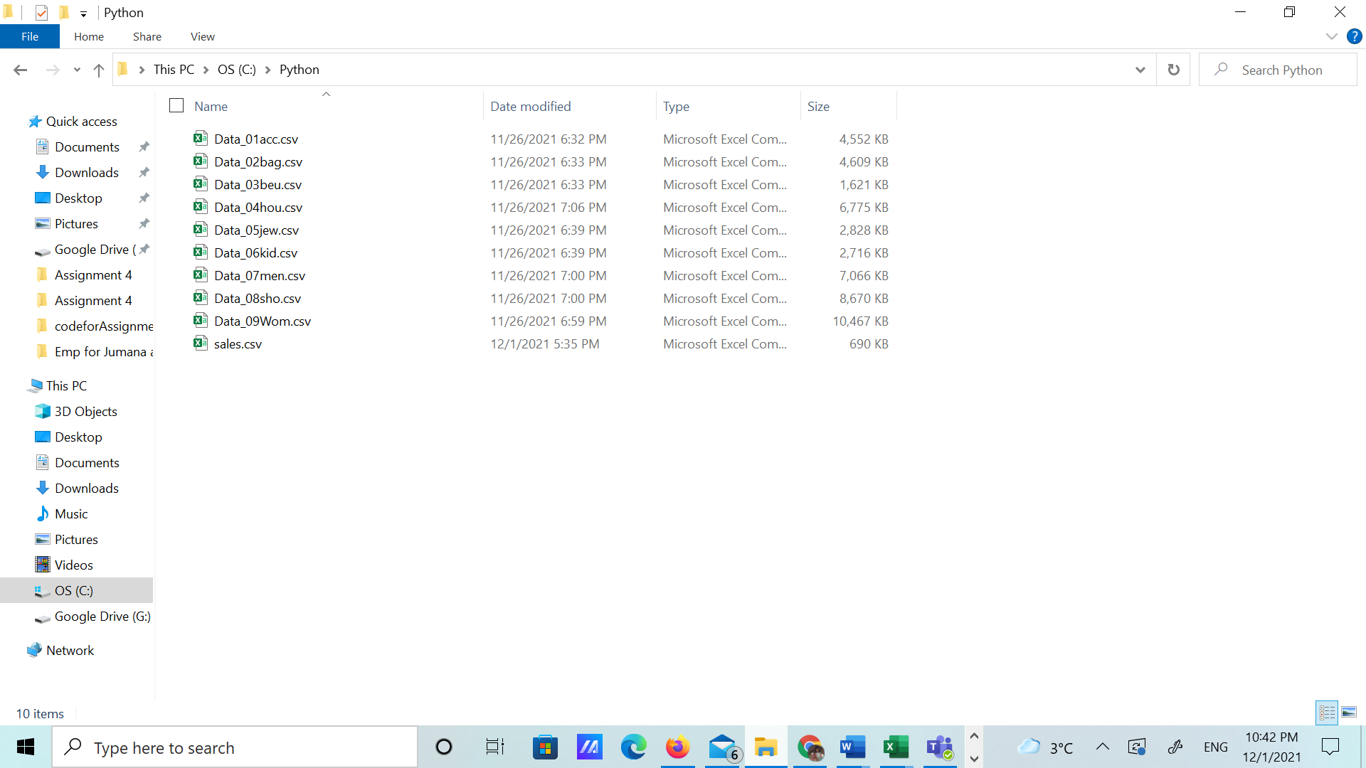
03
Current Performance & Analytics–Dataset

Slide 9
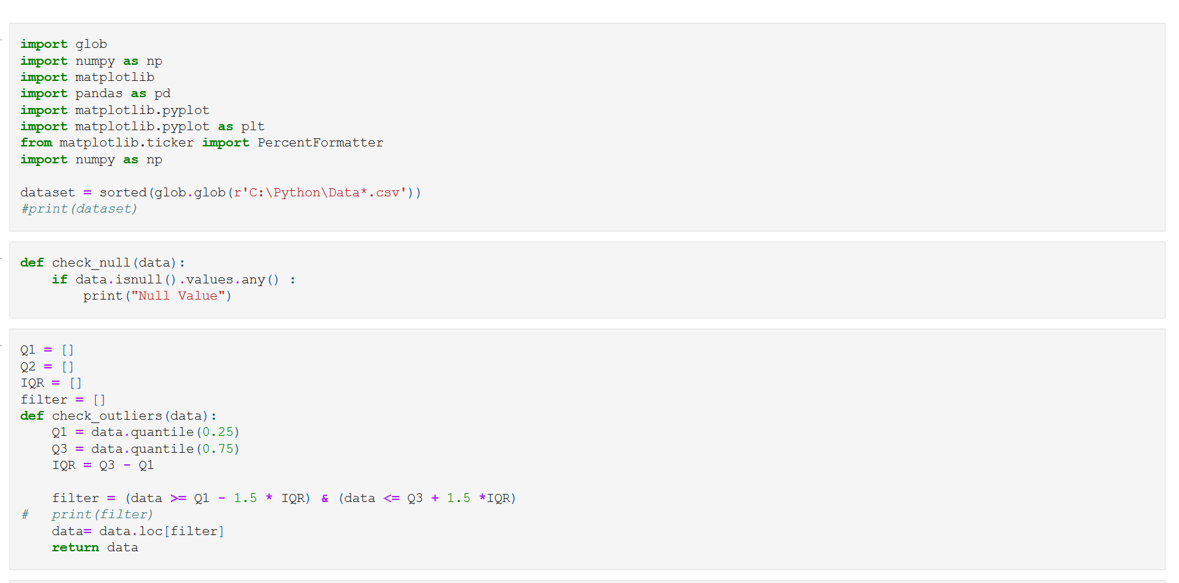
03
Current Performance & Analytics-Coding Scripts

Slide 10
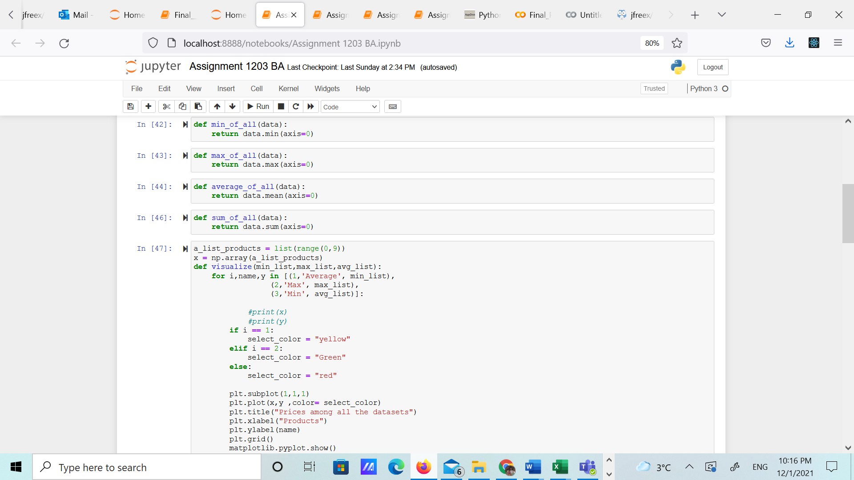
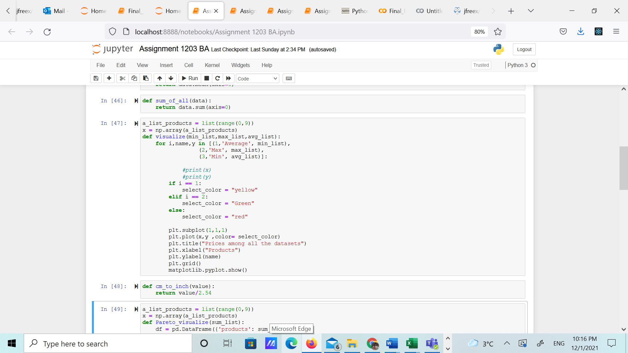

Slide 11
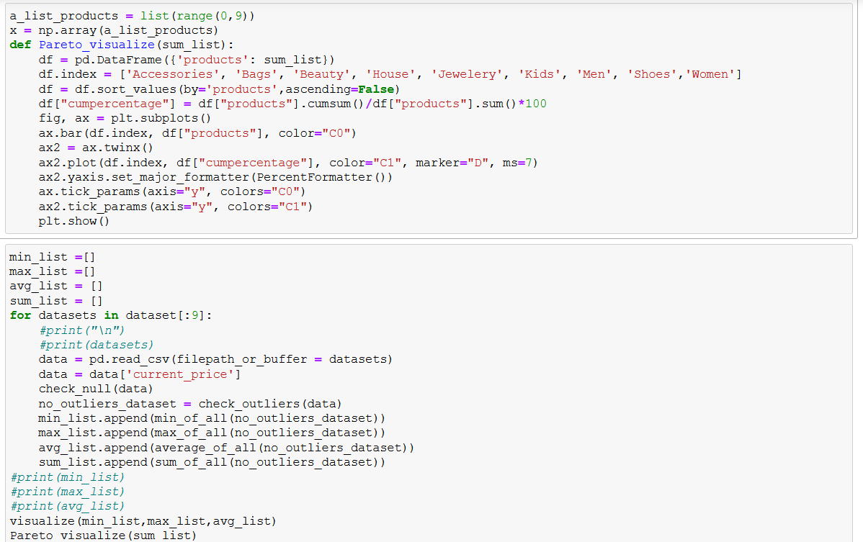

Slide 12
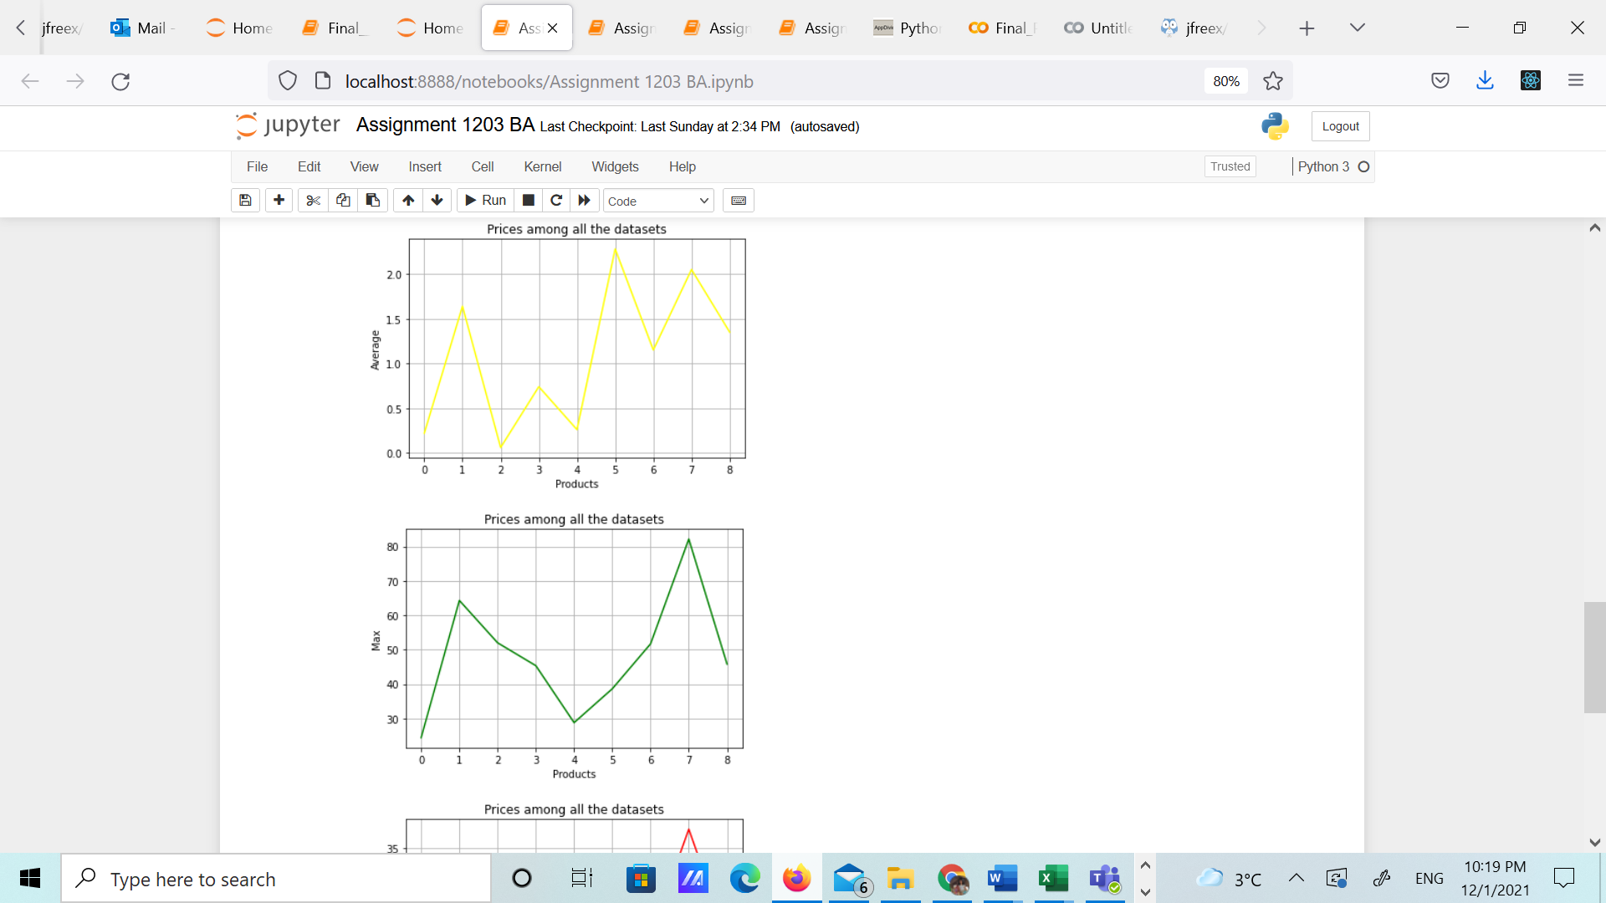
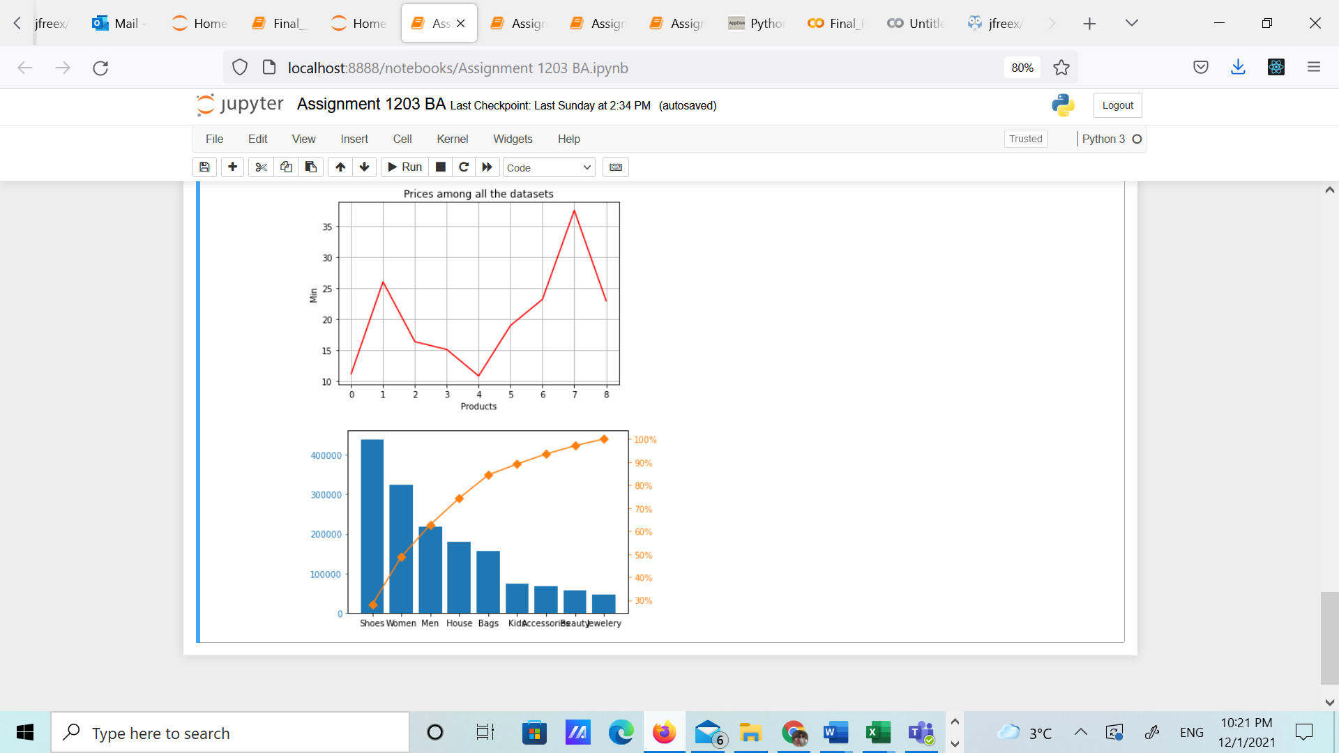
03
Current Performance & Analytics-Data Insights
At A Glance
The Highest Average & Maximum price among all the products in all the data sets are , 1 , 5 and 7 which are Accessories , Men and Jewelry –
Could be a good focus point for the charity to begin with.
In the pareto chart , the total Volume of the most sold products are Shoes, Women items & Men items.
Another way of looking into our preferences.

Slide 13
03
Current Performance & Analytics 2018-2021-continued
Overview Dashboard (PLEASE HARSH ADD POWERBI HERE)

Slide 14


04
Problem Statement- School Charities Struggles
The Key Problems
According to Imagine Canada.“68 per cent of organizations saw a decline in donations”. In these troubled times, with COVID and the Trans Canada Highway collapse, charities need support now more than ever.
School Charities are struggling to manage deliveries to the customers. Delay of orders or wrong deliveries would occur continuously, the supply chain wasn't structured. Thus leading to a large number of complaints from customers.
Different family income may affect the fund raising,skoolbazar open the doors for all students to participate with their talents and at zero cost.
Source: https://www.macleans.ca/longforms/covid-19-impact-on-charities/
Notes:
Problem Contd. Doesn’t look like a problem. So just leave it blank.

Slide 15
05
Approach
Full Delivery
Implementation
By 3rd party
This is our approach to the logistics process and to final delivery.
Request quotes from shipping companies
3rd party shipping will have lots of advantages and they can sponsor us.
They are experienced in packaging and delivery (we don’t have to worry about insurance issues for drivers or insurance on the delivery.
We don’t have to worry about salaries , hiring processes or any other logistic issues.
Decide on the charges and fees

Slide 16

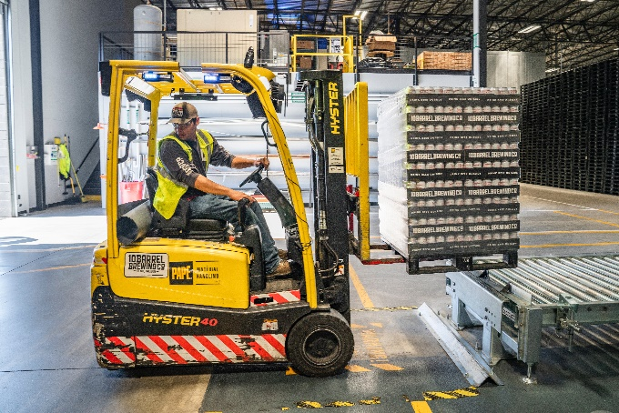
05
Methodology
Identify Warehouse Hubs / Locations
Discuss best locations that act as the main hub/warehouse in the region
Ideal distance between schools, minimize pick up time of goods
Quickest routes to customer, warehouse has to be centered around that
Minimize rent rates along the process.
Procurement (Machinery & Operational Staff)
Each school can decide on the web administrator , who can be a student or a teacher or may be a school administrator.
The web administrator is the one who will coordinate with the shipping company .
The web administrator will coordinate with other school if that was needed.

Slide 17




06
Schedule and Benchmarks
Implementation & registration (3 months)
Expansion in US (2 years)
The final product is already ready.
-Registering SkoolBazar as a charity project in the government.
-Logistics process & infrastructure
Aim to capture American market by 2 years.
Apply same logistic principles but be flexible with processes
Expansion in Canada (1 year)
End
-Operations will be ongoing, starting with Toronto & Vancouver
-Majority of Canadian schools will be onboarded
-Aim to capture majority of Canada by end year
This will be the initial timeline for 2-3 years
Worldwide coverage will be the next goal

Slide 18


06
Schedule and Benchmarks
Real time testing (3 months)
Implementation (Canada 1 year)
The testing on three schools in different
Areas.
-Warehouse location
-Logistics process
-Operations will be ongoing, starting with Toronto & Vancouver
-Majority of Canadian schools will be onboarded
-Aim to capture majority of Canada by end year
Procurement (6 months)
End
Acquiring the right personnel & machinery
-Having solid feedback from school administrators
For every aspect of the project and closely work with them to over come any difficulty either this was technical or logistic one.
Aim to capture American market by 2n years.
Apply same logistic principles but be flexible with processes

Slide 19
07
Cost and Payment Schedule
Benefits of 3rd party shipping company.
Full tracking
2-8 business days delivery*
Ship to any address in Canada
Benefit from their experience of the roads.
Chit Chats Insurance
Estimated cost :
We have two options :
Shipping company is our sponsor.
Another company will sponsor the shipping.

Slide 20
05
Projections Dashboard
How can investors benefit from our project ?
Investors who are ready to support students' talents and would like to participate in a solid charity project can also enjoy having advisements in the form of a banner on Skoolbazar portal for their products.
Provide access to student's talents especially digital art .

Slide 21

08
Legal, Terms and Conditions (Canada)
Terms 1: Registered charities are under both federal & provincial juris dictation. We have to file each charity under each province
Terms 2: Charities are tax exempt, ideal for operations
TERMS AND
CONDITIONS
Terms 3 Charity can issue official donation receipt which gives huge income tax savings to a donor who gets an official donation receipt
Terms 4 Can be considered a charity if its beneficial to the community in a way that regards as charitable and is of public benefit
Terms 5 Must file a T310 Registered Charity Information Return every year. Its important for transparency as a charity
Terms 6 Must cooperate with CRA for charity audits

Slide 22
2021
THANK YOU
Joumana | Harrish | Tianyi | Deepak
SkoolBazar

